Slide 1

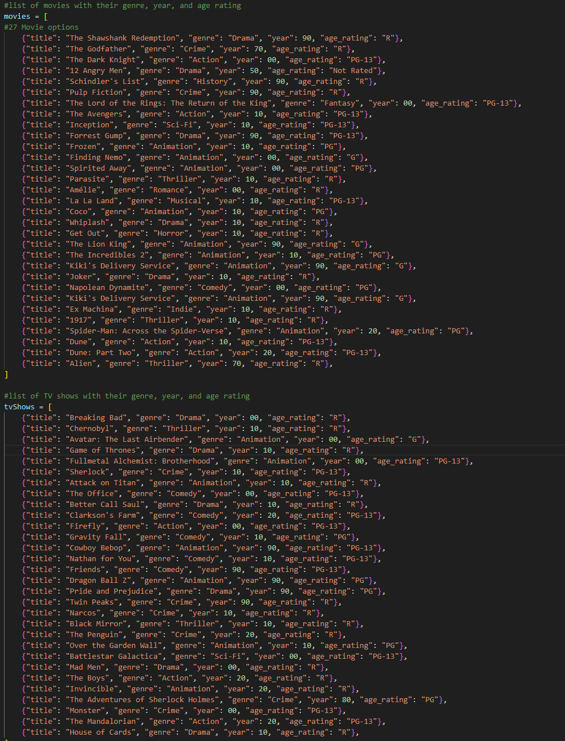
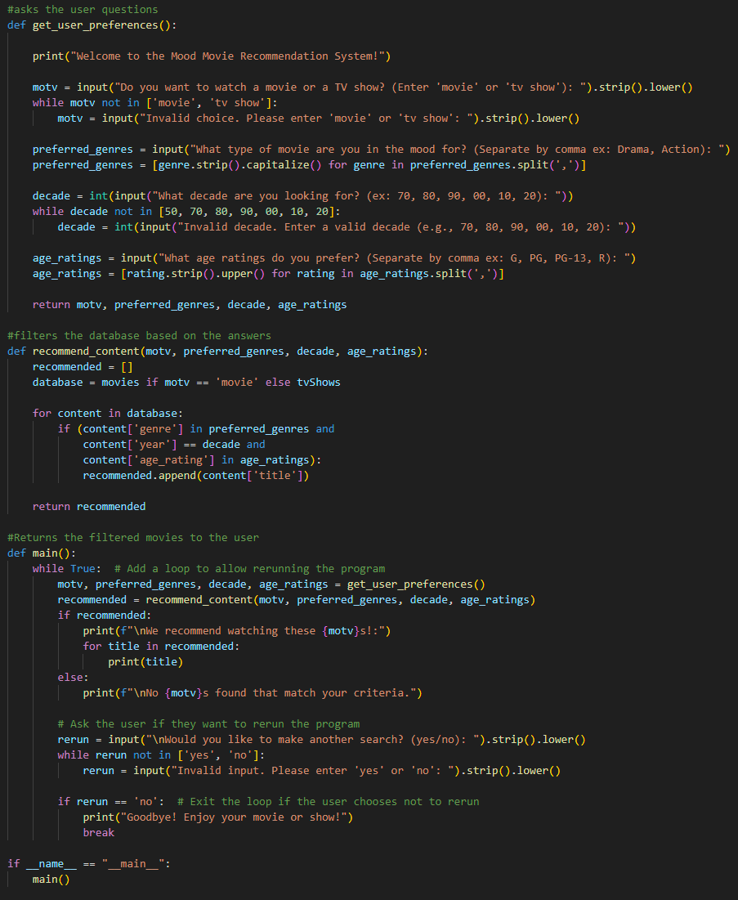
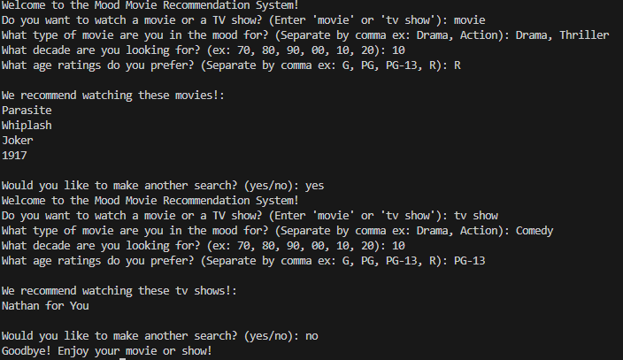
Movie Mood Recommender
By Wyatt Hickman
List of Movies & TV Shows
Asks Questions and Filters Answers
Output
This is a movie recommender program that asks the user some questions and it will generate either movies or TV shows recommendations for the user to watch

